Slide 1

Interface LCD with PIC
DAY 24
EMBEDDED SYSTEM DESIGN & IoT-Master Class

Slide 2
What You will learn Today?
Overview of LCD
Interface LCD with PIC

Slide 3
Mindset Lesson for the Day
Words has power to Create
And Power to destroy.

Slide 4
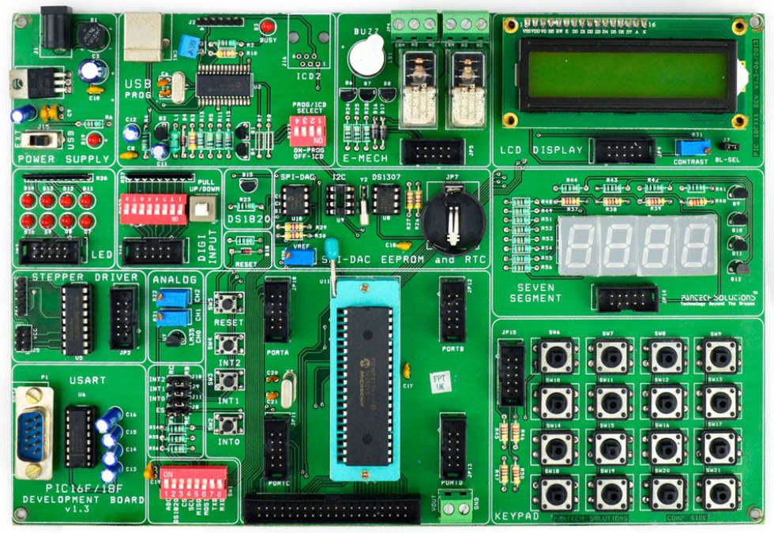
Embedded System Design using PIC
40pin-SIF Socket
8 Nos. Point LEDs (Logic Output)
8 Nos. Digital Input (DIP Switch)
4x4 Matrix Keypad
2X16 Character LCD (Background Light)
4 Nos. 7-Segment Display
2 Nos. Analog Input (Potentiometer)
Temperature Sensor (LM35)
Stepper Motor Interface
2 Nos. of SPST Relay
DS1307 RTC with Batter-Backup
USART(RS232)
USB 2.0 Enabled Programmer
Interrupts Study, Reset Button
SPI – EEPROM.25C040
I2C EEPROM 24C04
Digital Temperature Sensor(DS18S20)
4x10-Pin Expansion Connector
Piezo Electric Buzzer

Slide 5
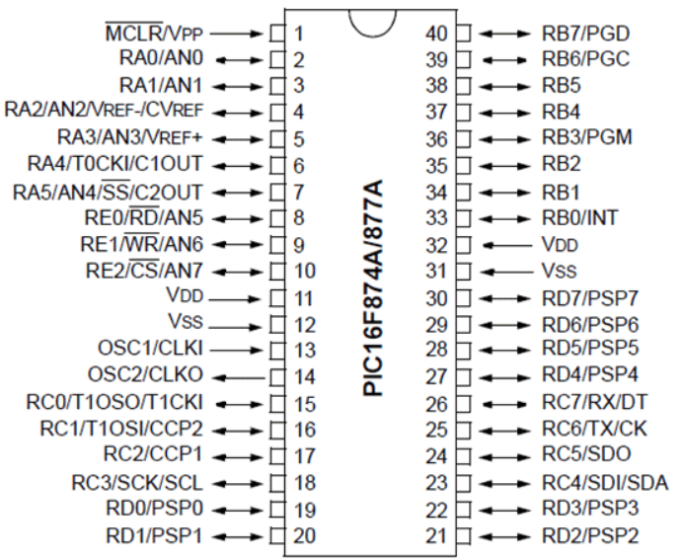
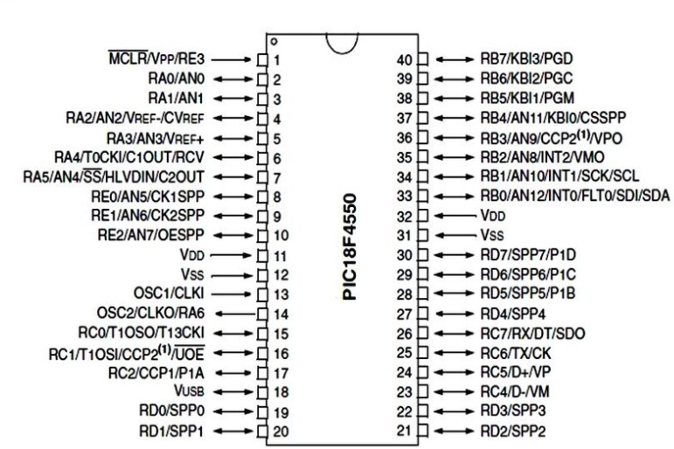
PIC PIN Diagram

Slide 6
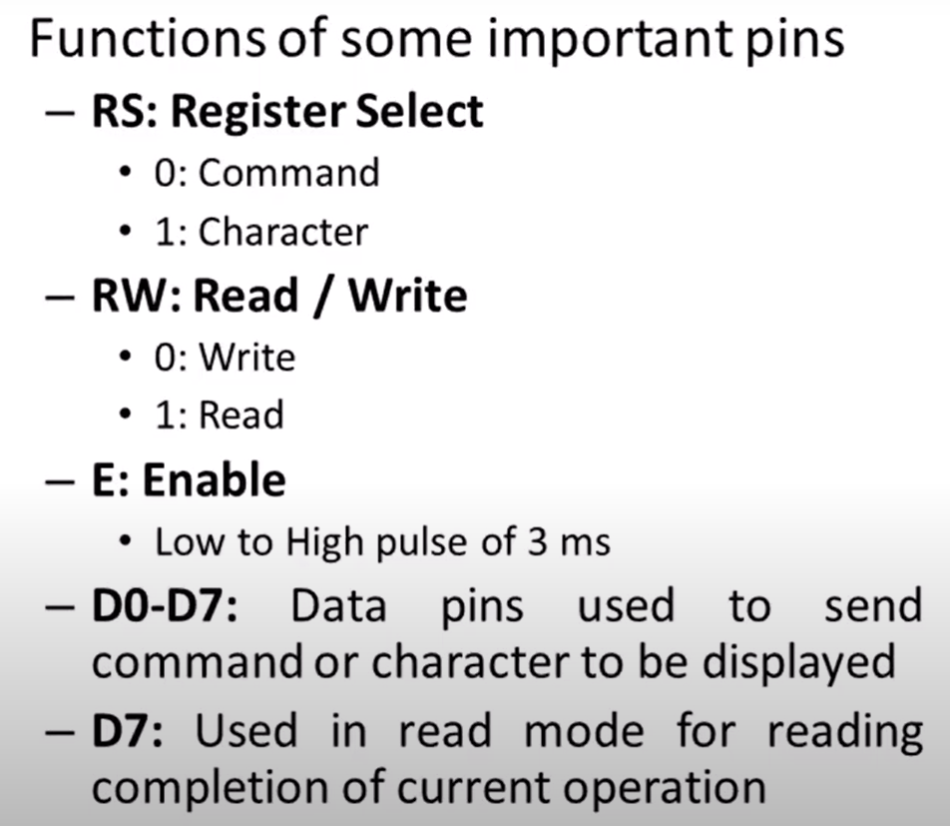
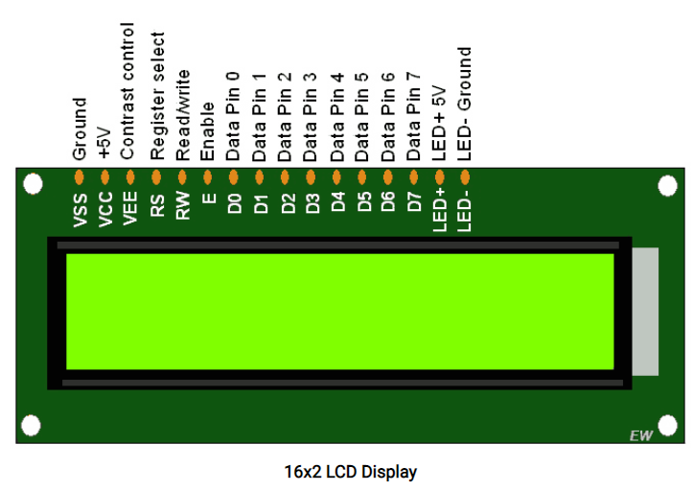
PIN Details of LCD

Slide 7
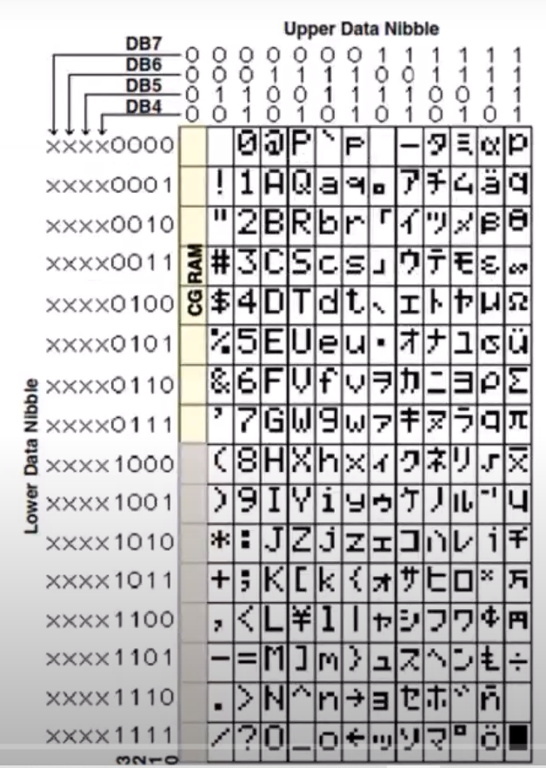
Character Display LCD
0011 0001 -X”31”
0011 0010 -X”32”

Slide 8
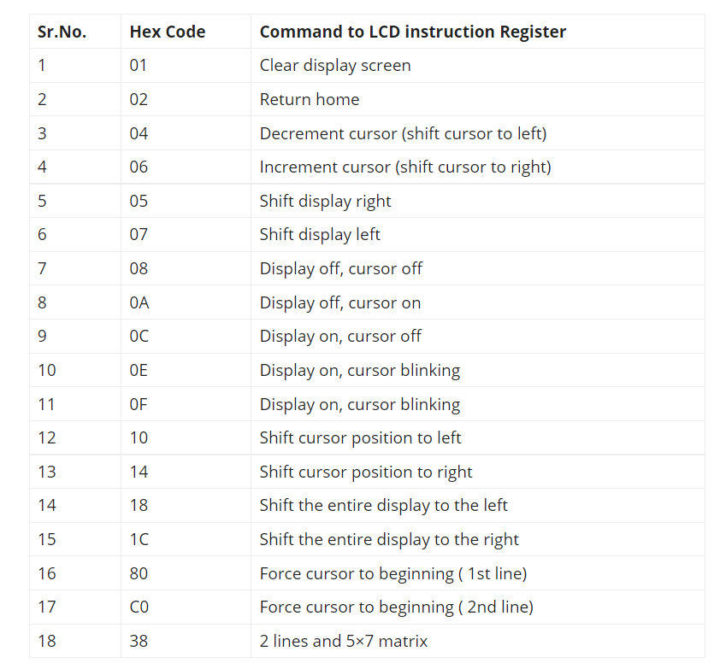
COMMAND CODES

Slide 9
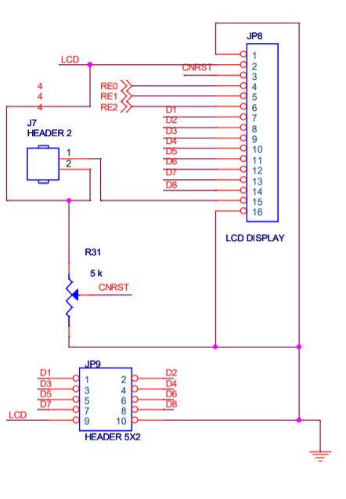
Schematic Diagram of LCD

Slide 10
Header File and Declarations
#include<pic.h> //Define PIC Registers
#include<stdio.h> //Define I/O Functions
__CONFIG(0x3f72);
#define RS RE0 //LCD Register Select
#define RW RE1 //LCD Read/Write Pin
#define EN RE2 //LCD Enable Pin
#define DATA PORTD //LCD Data Port
#define DATADIR TRISD //LCD Data Port Direction Register
#define CNTRLDIR TRISE //RS,RW,EN Direction Register
void lcdinit(void); //LCD initialization Function
void lcdclr(void); //LCD Clear Function
void lcdcomd(unsigned char); //LCD Command Declaring Fucntion
void lcddata(unsigned char); //LCD Data Display Fucntion
void DelayMs(unsigned int);

Slide 11
Main
void main()
{
int i;
unsigned char First[]={" PIC DEV. BOARD "};
unsigned char Secnd[]={"LCD DEMO PROGRAM"};
DelayMs(500);
lcdinit();
DelayMs(500);
while(1)
{
lcdclr();
lcdcomd(0x80);
for(i=0;i<16;i++) //Display the Message
{
lcddata(First[i]);
DelayMs(50);
}
lcdcomd(0xc0);
for(i=0;i<16;i++) //Display the Message
{
lcddata(Secnd[i]);
DelayMs(50);
}
DelayMs(500);
}
}

Slide 12
LCD Initialization
void lcdinit(void)
{
int i;
unsigned char command[]={0x38,0x0c,0x06,0x01}; //LCD Command set for 8 bit Interface, 2 Lines, 5x7 Dots
ADCON1 = 0x07; //Make PORTE Pin as Digital
CNTRLDIR = 0x00; //Make LCD control port (PORTE) as output Port
DATADIR = 0x00;
DelayMs(50); //Make LCD Data Port (PORTD) as output port
for(i=0;i<4;i++)
{
lcdcomd(command[i]); //Send the Initialisation Commands
DelayMs(5);
}
DelayMs(500);
}

Slide 13
LCD COMMAND
void lcdclr(void) //Send LCD clear command
{
lcdcomd(0x01);
DelayMs(2);
}
void lcdcomd(unsigned char cmd)
{
RS=0; RW=0; //Select Command Register, R/W--write enabled
EN=1; //Enable LCD to accept commands
DATA=cmd;
EN=0;
DelayMs(5); //Give a Pulse via Enable pin
}

Slide 14
LCD Data
void lcddata(unsigned char byte)
{
RS=1; RW=0; //Select Data register, R/W--write enabled
EN=1;
DATA=byte; //Give a Pulse via Enable pin
EN=0;
DelayMs(5);
}
void DelayMs(unsigned int Ms)
{
int delay_cnst;
while(Ms>0)
{
Ms--;
for(delay_cnst = 0;delay_cnst <220;delay_cnst++);
}
}

Slide 15
Thank You

